Slide 1

Computer Networks
The Transport Layer
Lecture # 07

Slide 2
Introduction
Residing between the application and network layers, the transport layer is a central piece of the layered network architecture.
Critical role of providing communication services directly to the application processes running on different hosts.
TCP and UDP Protocols
Transport-layer protocols are implemented in the end systems but not in network routers.

Slide 3
Main discussions:
Extending the network layer’s delivery service between two end systems to a delivery service between two application-layer processes running on the end systems.
How can two entities communicate reliably over a medium that may lose and corrupt data?
Controlling the transmission rate of transport-layer entities in order to avoid, or recover from, congestion within the network.

Slide 4
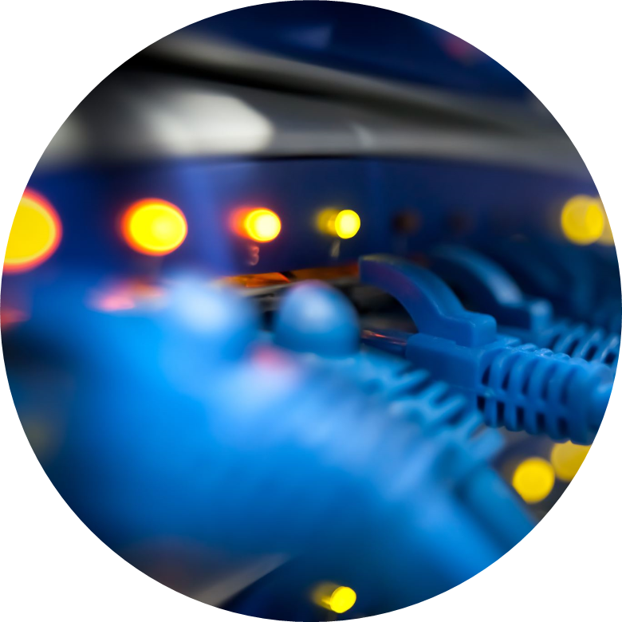
Transport Layer Services
Logical Communication between Application and Network Layer.
Segmentation
Transport Layer Header added to Application layer data.
Reliable data delivery over unreliable Network Layer Protocol.
Provide Security of Data
Error Detection
Congestion Control
Notes:
Application processes use the logical communication provided by the transport layer to send messages to each other, free from the worry of the details of the physical infrastructure used to carry these messages.
a transport protocol can use encryption to guarantee that application messages are not read by intruders, even when the network layer cannot guarantee the confidentiality of transport-layer segments.

Slide 5
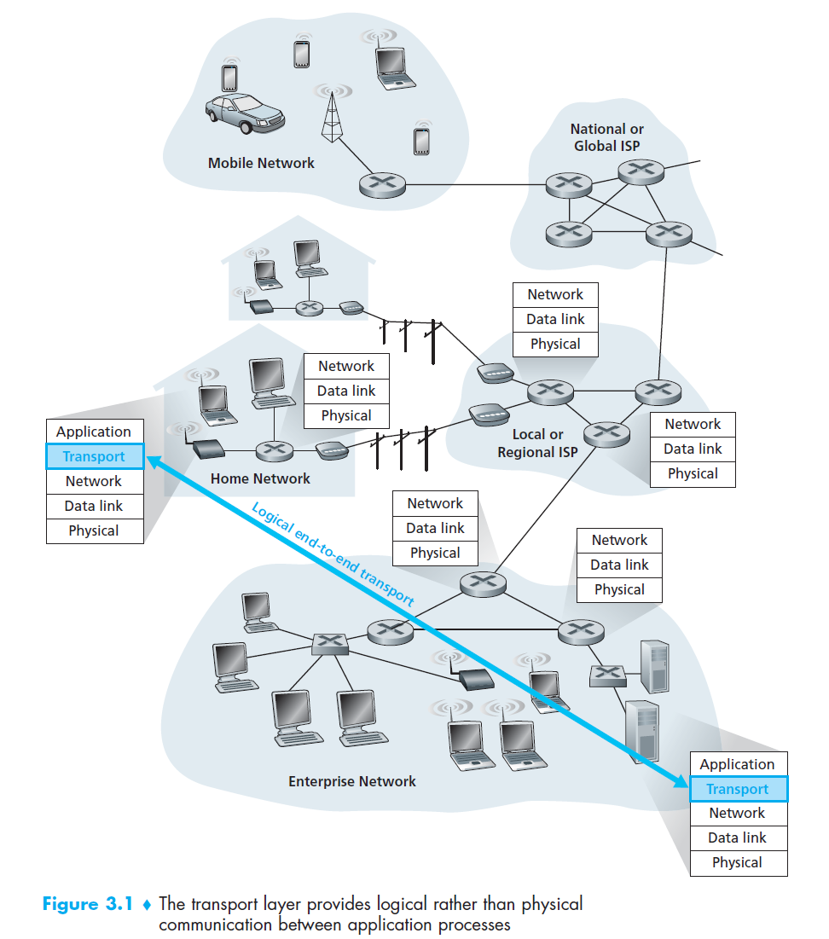

Slide 6
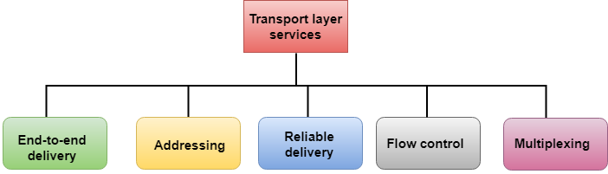
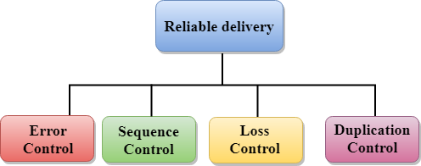
Services

Slide 7
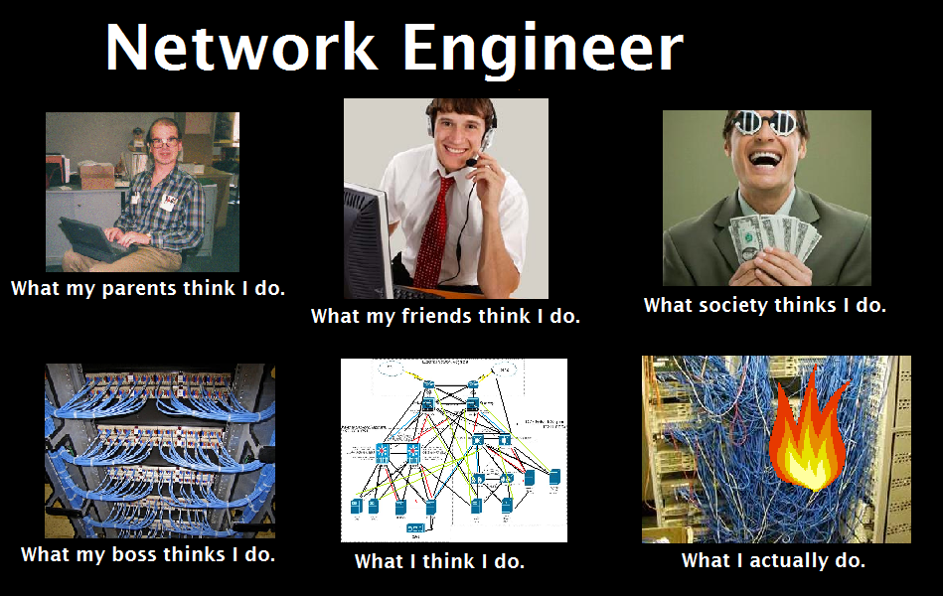

Slide 8
Example
application messages = letters in envelopes
processes = cousins
hosts (also called end systems) = houses
transport-layer protocol = Uncle Sam and Uncle Bill
network-layer protocol = postal service (including mail carriers)
Sam and Bill replaced by Harvey and Specter but not very efficient.
Notes:
a computer network may make available multiple transport protocols, with each protocol offering a different service model to applications.

Slide 9




Transport Layer V/S Network Layer
An Analogy: Cousins sending letters
East Coast
West Coast
Postal-service mail carrier
Uncle Sam
Uncle Bill
Uncle Sam & Uncle Bill - responsible for mail collection, distribution, and communicating with postal service
Postal service – carries the mails from house to house

Slide 10
The services that a transport protocol can provide are often constrained by the service model of the underlying network-layer protocol. If the network-layer protocol cannot provide delay or bandwidth guarantees for transport layer segments sent between hosts, then the transport-layer protocol cannot provide delay or bandwidth guarantees for application messages sent between processes.

Slide 11
Network Layer
Network Layer Protocol- Internet Protocol IP
IP provides logical communication between hosts.
The IP service model is a best-effort delivery service. This means that IP makes its “best effort” to deliver segments between communicating hosts, but it makes no guarantees. In particular, it does not guarantee segment delivery, it does not guarantee orderly delivery of segments, and it does not guarantee the integrity of the data in the segments. For these reasons, IP is said to be an unreliable service.
Every host has at least one network-layer address, a so-called IP address.

Slide 12
Transport Layer Protocols
UDP- User Datagram Protocol- Simple
TCP- Transmission Control Protocol- Complex.
SCTP- Stream Control Transport Protocol- Designed for Multimedia Applications
Note: The most fundamental responsibility of UDP and TCP is to extend IP’s delivery service between two end systems to a delivery service between two processes running on the end systems. Extending host-to-host delivery to process-to-process delivery is called transport-layer multiplexing and demultiplexing.

Slide 13
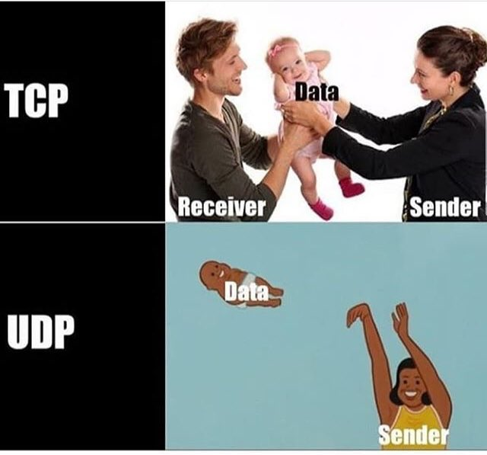

Slide 14
UDP- User Datagram Protocol
Connectionless
Unreliable
Packets called Datagrams/ Segments.
Services provided are:
Process-to-Process Data Delivery
Error Checking

Slide 15
TCP- Transmission Control Protocol
Connection Oriented
Reliable and in-order Data Delivery
Flow Control
Congestion Control
Notes:
Using flow control, sequence numbers, acknowledgments, and timers, TCP ensures that data is delivered from sending process to receiving process, correctly and in order

Slide 16
Note:
Congestion control is not so much a service provided to the invoking application as it is a service for the Internet as a whole, a service for the general good. Loosely speaking, TCP congestion control prevents any one TCP connection from swamping the links and routers between communicating hosts with an excessive amount of traffic. TCP strives to give each connection traversing a congested link an equal share of the link bandwidth. This is done by regulating the rate at which the sending sides of TCP connections can send traffic into the network.
UDP traffic, on the other hand, is unregulated. An application using UDP transport can send at any rate it pleases, for as long as it pleases.

Slide 17
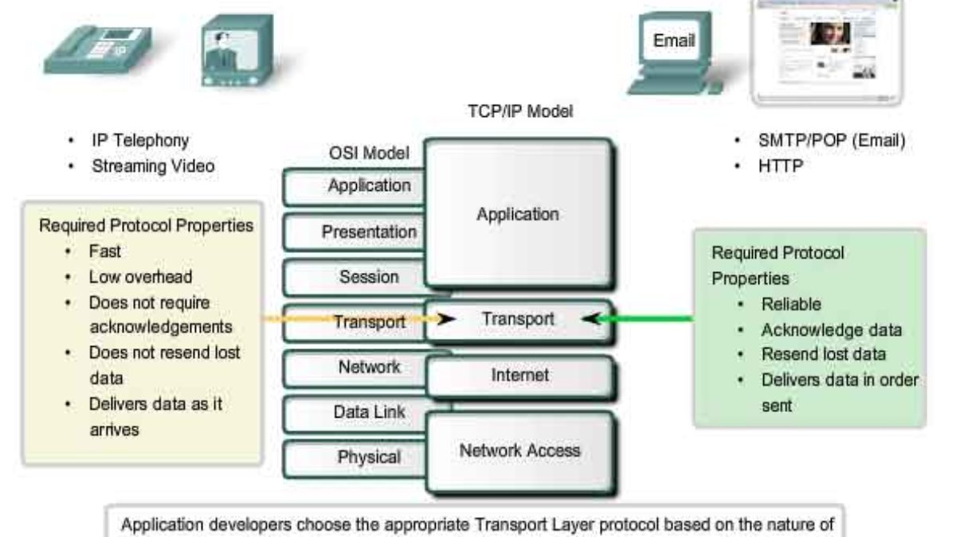

Slide 19
Multiplexing & Demultiplexing
The job of gathering data chunks at the source host from different sockets, encapsulating each data chunk with header information (that will later be used in demultiplexing) to create segments, and passing the segments to the network layer is called multiplexing.
A receiving host directs an incoming transport-layer segment to the appropriate socket. Each transport-layer segment has a set of fields in the segment for this purpose. At the receiving end, the transport layer examines these fields to identify the receiving socket and then directs the segment to that socket. This job of delivering the data in a transport-layer segment to the correct socket is called demultiplexing.
Notes:
A process (as part of a network application) can have one or more sockets, doors through which data passes from the network to the process and through which data passes from the process to the network. Thus, as shown in Figure 3.2, the transport layer in the receiving host does not actually deliver data directly to a process, but instead to an intermediary socket. Because at any given time there can be more than one socket in the receiving host, each socket has a unique identifier. The format of the identifier depends on whether the socket is a UDP or a TCP socket

Slide 20
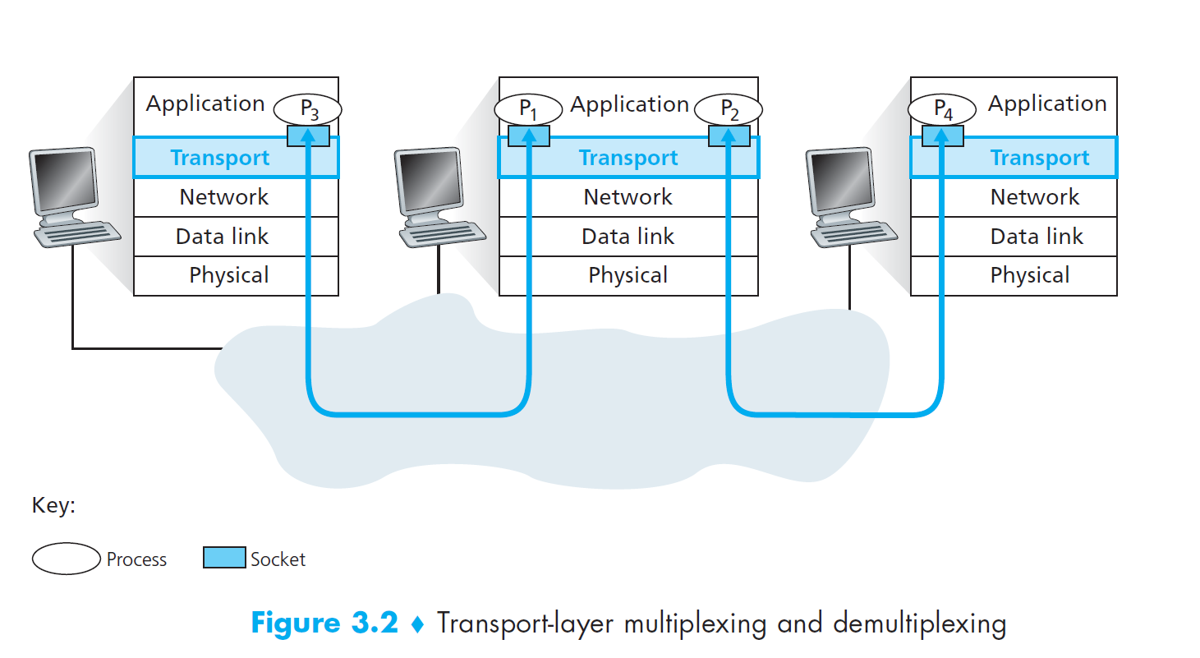

Slide 22
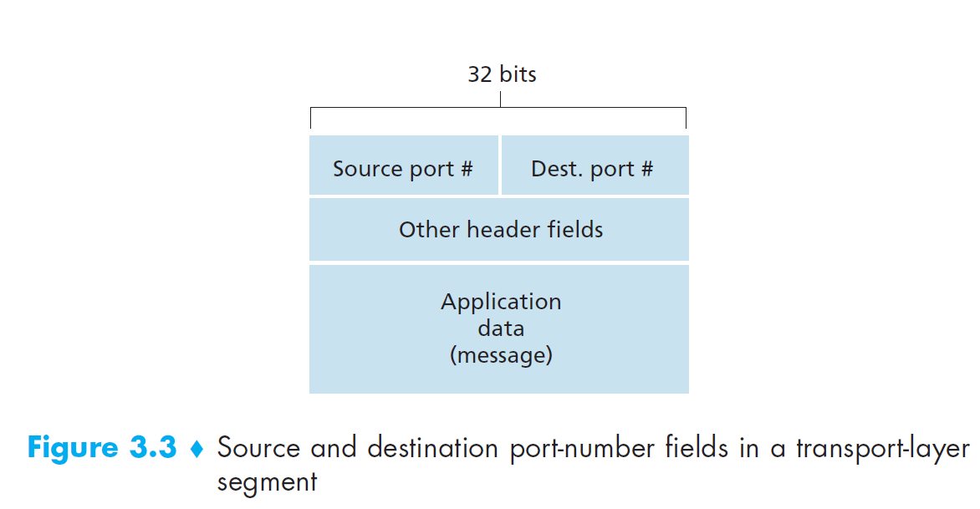
Transport-layer multiplexing requires
that sockets have unique identifiers , and
that each segment have special fields that indicate the socket to which the segment is to be delivered i.e., Source port number field and Destination port number field

Slide 23
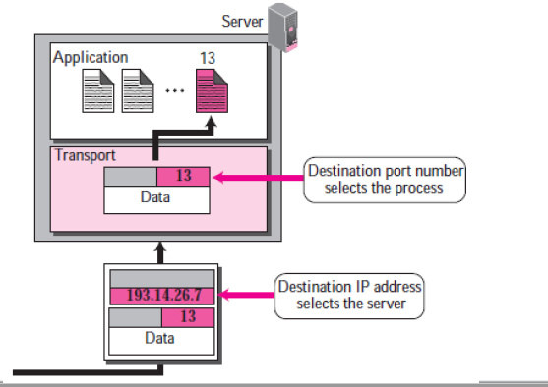

Slide 24
Ports
Each port number is a 16-bit number, ranging from 0 to 65535.
Every application is assigned a port number.
There are Well-known ports, Registered and Dynamic ports

Slide 25
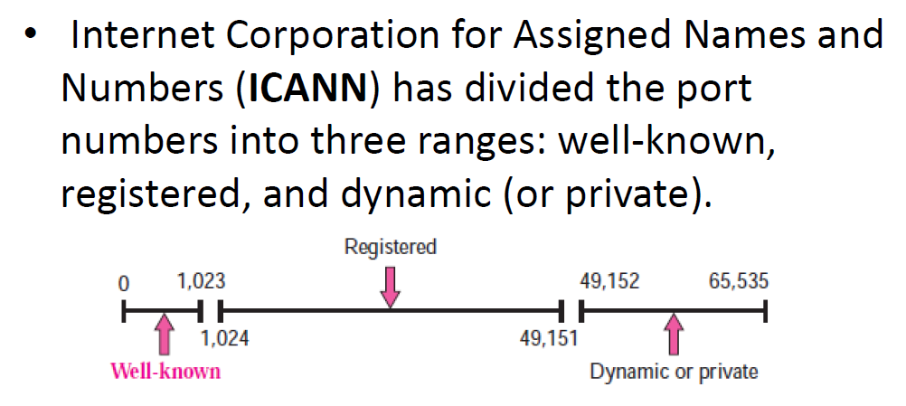
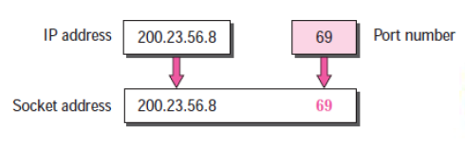
Socket Address is the combination of IP Address and Port Number.

Slide 26
Well known ports
The port numbers ranging from 0 to 1023 are called well-known port numbers and are restricted, which means that they are reserved for use by well-known application protocols such as HTTP (which uses port number 80) and FTP (which uses port number 21).
The list of well-known port numbers is given in RFC 1700.

Slide 27
UDP: User Datagram Protocol [RFC 768]
“no frills,” “bare bones” Internet transport protocol
“best effort” service, UDP segments may be:
lost
delivered out-of-order to app
connectionless:
no handshaking between UDP sender, receiver
each UDP segment handled independently of others
UDP use:
streaming multimedia apps (loss tolerant, rate sensitive)
DNS
SNMP
reliable transfer over UDP:
add reliability at application layer
application-specific error recovery!
Notes:
RIP uses UDP

Slide 29
UDP: segment header
length, in bytes of UDP segment, including header
32 bits
source port #
dest port #
length
checksum
why is there a UDP?
no connection establishment (which can add delay)
simple: no connection state at sender, receiver
small header size
no congestion control: UDP can blast away as fast as desired
application
data
(payload)
UDP segment format

Slide 30
UDP checksum
Goal: detect “errors” (e.g., flipped bits) in transmitted segment
sender:
treat segment contents, including header fields, as sequence of 16-bit integers
checksum: addition (one’s complement sum) of segment contents
sender puts checksum value into UDP checksum field
receiver:
compute checksum of received segment
check if computed checksum equals checksum field value:
NO - error detected
YES - no error detected. But maybe errors nonetheless? More later ….

Slide 31
Internet checksum: example
example: add two 16-bit integers
1 1 1 1 0 0 1 1 0 0 1 1 0 0 1 1 0
1 1 1 0 1 0 1 0 1 0 1 0 1 0 1 0 1
1 1 0 1 1 1 0 1 1 1 0 1 1 1 0 1 1
1 1 0 1 1 1 0 1 1 1 0 1 1 1 1 0 0
1 0 1 0 0 0 1 0 0 0 1 0 0 0 0 1 1
wraparound
sum
checksum
Note: when adding numbers, a carryout from the most significant bit needs to be added to the result
Notes:
Kurose and Ross forgot to say anything about wrapping the carry and adding it to low order bit

Slide 32
Connectionless Multiplexing and Demultiplexing
Client side is assigned a port number automatically in the range of 1024-65535.
Server-Side application has a specific port number.
Unique port numbers for the applications running on the same host.
UDP socket is fully identified by a two-tuple consisting of a destination IP address and a destination port number.
Source port number serves as part of a “return address”

Slide 33
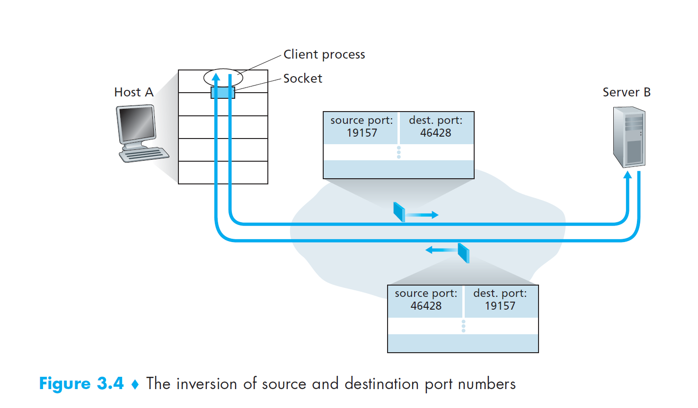

Slide 35

Connectionless demux: example
DatagramSocket serverSocket = new DatagramSocket
(6428);
DatagramSocket mySocket2 = new DatagramSocket
(9157);
DatagramSocket mySocket1 = new DatagramSocket (5775);
application
application
P1
application
P3
P4
transport
transport
network
transport
network
link
network
link
physical
link
physical
physical
source port: 6428
dest port: 9157
source port: ?
dest port: ?
source port: 9157
dest port: 6428
source port: ?
dest port: ?
Notes:
Multicast and broadcast possible using UDP

Slide 36
TCP: overview RFCs: 793,1122, 2018, 5681, 7323
point-to-point:
one sender, one receiver
reliable, in-order byte steam:
no “message boundaries"
full duplex data:
bi-directional data flow in same connection
MSS: maximum segment size
cumulative ACKs
pipelining:
TCP congestion and flow control set window size
connection-oriented:
handshaking (exchange of control messages) initializes sender, receiver state before data exchange
flow controlled:
sender will not overwhelm receiver
Notes:
Typical MSS is 1460 bytes

Slide 37
TCP segment structure
32 bits
source port #
dest port #
segment seq #: counting bytes of data into bytestream (not segments!)
ACK: seq # of next expected byte; A bit: this is an ACK
sequence number
acknowledgement number
length (of TCP header)
head
len
not
used
A
P
S
receive window
flow control: # bytes receiver willing to accept
C
E
U
R
F
Internet checksum
checksum
Urg data pointer
options (variable length)
C, E: congestion notification
TCP options
application
data
(variable length)
data sent by application into TCP socket
RST, SYN, FIN: connection management

Slide 38
TCP sequence numbers, ACKs
outgoing segment from sender
Sequence numbers:
byte stream “number” of first byte in segment’s data
source port #
dest port #
sequence number
acknowledgement number
rwnd
checksum
urg pointer
window size
N
Acknowledgements:
seq # of next byte expected from other side
cumulative ACK
sender sequence number space
sent
ACKed
sent, not-yet ACKed
(“in-flight”)
usable
but not
yet sent
not
usable
Q: how receiver handles out-of-order segments
A: TCP spec doesn’t say, - up to implementor
outgoing segment from receiver
source port #
dest port #
sequence number
acknowledgement number
A
rwnd
checksum
urg pointer

Slide 40
Connection Management
before exchanging data, sender/receiver “handshake”:
agree to establish connection (each knowing the other willing to establish connection)
agree on connection parameters
application
application
connection state: ESTAB
connection variables:
seq # client-to-server
server-to-client
rcvBuffer size
at server,client
connection state: ESTAB
connection Variables:
seq # client-to-server
server-to-client
rcvBuffer size
at server,client
network
network
Socket clientSocket =
newSocket("hostname","port number");
Socket connectionSocket = welcomeSocket.accept();

Slide 42


Agreeing to establish a connection
2-way handshake:
Q: will 2-way handshake always work in network?
variable delays
retransmitted messages (e.g. req_conn(x)) due to message loss
message reordering
can’t “see” other side
Let’s talk
ESTAB
OK
ESTAB
choose x
req_conn(x)
ESTAB
acc_conn(x)
ESTAB

Slide 43
Agreeing to establish a connection
2-way handshake failure scenarios:
choose x
choose x
req_conn(x)
req_conn(x)
ESTAB
ESTAB
retransmit
req_conn(x)
acc_conn(x)
retransmit
req_conn(x)
acc_conn(x)
ESTAB
ESTAB
data(x+1)
accept
data(x+1)
req_conn(x)
retransmit
data(x+1)
connection
x completes
connection
x completes
client terminates
server
forgets x
client terminates
server
forgets x
req_conn(x)
ESTAB
data(x+1)
ESTAB
half open connection!
(no client!)
accept
data(x+1)

Slide 44
TCP 3-way handshake
client state
server state
LISTEN
LISTEN
choose init seq num, x
send TCP SYN msg
SYNSENT
SYNbit=1, Seq=x
choose init seq num, y
send TCP SYNACK
msg, acking SYN
SYN RCVD
SYNbit=1, Seq=y
ACKbit=1; ACKnum=x+1
received SYNACK(x)
indicates server is live;
send ACK for SYNACK;
this segment may contain
client-to-server data
ESTAB
ACKbit=1, ACKnum=y+1
received ACK(y)
indicates client is live
ESTAB

Slide 45
TCP 3-way handshake: FSM
closed
Socket connectionSocket = welcomeSocket.accept();
Λ
Socket clientSocket =
newSocket("hostname","port number");
SYN(x)
SYNACK(seq=y,ACKnum=x+1)
create new socket for
communication back to client
listen
SYN(seq=x)
SYN
rcvd
SYN
sent
SYNACK(seq=y,ACKnum=x+1)
ACK(ACKnum=y+1)
ESTAB
ACK(ACKnum=y+1)
Λ

Slide 46
TCP: closing a connection
client, server each close their side of connection
send TCP segment with FIN bit = 1
respond to received FIN with ACK
on receiving FIN, ACK can be combined with own FIN
simultaneous FIN exchanges can be handled

Slide 47
TCP: closing a connection
client state
server state
ESTAB
ESTAB
clientSocket.close()
FIN_WAIT_1
can no longer
send but can
receive data
FINbit=1, seq=x
CLOSE_WAIT
ACKbit=1; ACKnum=x+1
can still
send data
FIN_WAIT_2
wait for server
close
LAST_ACK
FINbit=1, seq=y
TIMED_WAIT
can no longer
send data
ACKbit=1; ACKnum=y+1
timed wait
for 2*max
segment lifetime
CLOSED
CLOSED

Slide 48
Connection-Oriented Multiplexing and Demultiplexing
A TCP socket is identified by a four-tuple: (source IP address, source port number, destination IP address, destination port number).
Notes:
In particular, and in contrast with UDP, two arriving TCP segments with different source IP addresses or source port numbers will (with the exception of a TCP segment carrying the original connection-establishment request) be directed to two different sockets.

Slide 49
The TCP server application has a “welcoming socket,” that waits for connection establishment requests from TCP clients on port number 12000.
The TCP client creates a socket and sends a connection establishment request segment.
A connection-establishment request is nothing more than a TCP segment with destination port number 12000 and a special connection-establishment bit set in the TCP header. The segment also includes a source port number that was chosen by the client.
When the host operating system of the computer running the server process receives the incoming connection-request segment with destination port 12000, it locates the server process that is waiting to accept a connection on port number 12000. The server process then creates a new socket.
Notes:
Server port # 12000.

Slide 50
Also, the transport layer at the server notes the following four values in the connection- request segment:
the source port number in the segment,
the IP address of the source host,
the destination port number in the segment, and
its own IP address.
The newly created connection socket is identified by these four values; all subsequently arriving segments whose source port, source IP address, destination port, and destination IP address match these four values will be demultiplexed to this socket.
With the TCP connection now in place, the client and server can now send data to each other.
Notes:
The server host may support many simultaneous TCP connection sockets, with each socket attached to a process, and with each socket identified by its own fourtuple. When a TCP segment arrives at the host, all four fields (source IP address, source port, destination IP address, destination port) are used to direct (demultiplex) the segment to the appropriate socket.

Slide 51
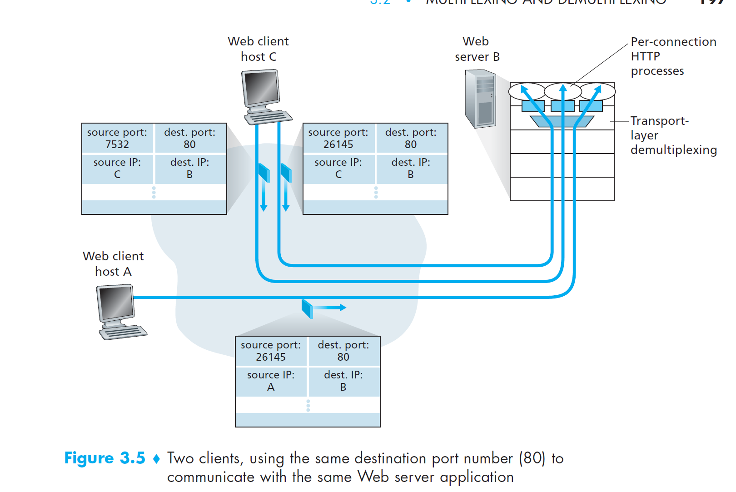

Slide 52
Connection-oriented demux: example
application
application
P4
P5
P6
application
P3
P2
P3
transport
transport
network
transport
network
link
network
link
physical
link
physical
server: IP address B
physical
host: IP address A
source IP,port: B,80
dest IP,port: A,9157
host: IP address C
source IP,port: C,5775
dest IP,port: B,80
source IP,port: A,9157
dest IP, port: B,80
source IP,port: C,9157
dest IP,port: B,80
three segments, all destined to IP address: B,
dest port: 80 are demultiplexed to different sockets

Slide 53
Web Servers and TCP
Today’s high-performing Web servers often use only one process, and create a new thread with a new connection socket for each new client connection.
A thread can be viewed as a lightweight subprocess.
For such a server, at any given time there may be many connection sockets (with different identifiers) attached to the same process.
Web Servers performance affected by non-persistent connections
Notes:
If the client and server are using persistent HTTP, then throughout the duration
of the persistent connection the client and server exchange HTTP messages via the
same server socket. However, if the client and server use non-persistent HTTP, then
a new TCP connection is created and closed for every request/response, and hence
a new socket is created and later closed for every request/response. This frequent
creating and closing of sockets can severely impact the performance of a busy Web
server (although a number of operating system tricks can be used to mitigate
the problem).

Slide 54
Connection-oriented demux: example
threaded server
application
application
application
P4
P3
P3
P2
transport
transport
network
transport
network
link
network
link
physical
link
physical
server: IP address B
physical
host: IP address A
source IP,port: B,80
dest IP,port: A,9157
host: IP address C
source IP,port: C,5775
dest IP,port: B,80
source IP,port: A,9157
dest IP, port: B,80
source IP,port: C,9157
dest IP,port: B,80

Slide 55
Transmission Protocols
Stop-and-Wait Protocol
Pipelined Protocols
Go-Back-N Protocol
Selective-Repeat Protocol
Notes:
Acks, NAKs Negative Acknowledgements

Slide 56
Stop and Wait

Slide 57
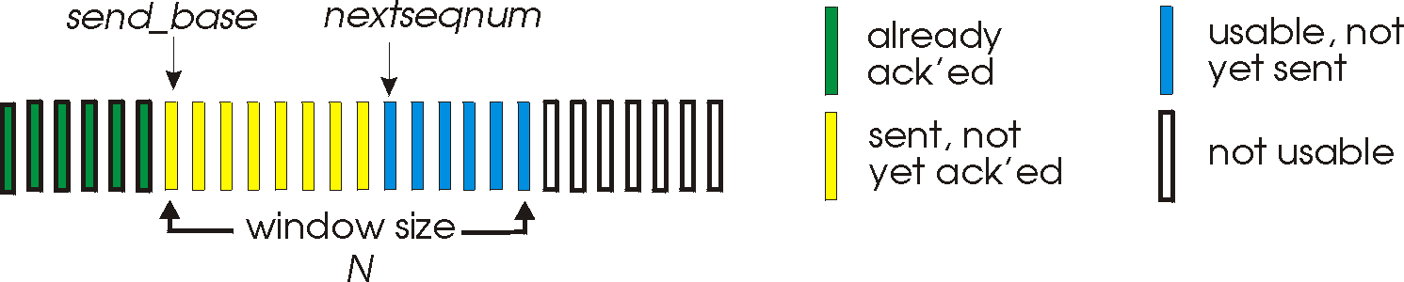
Go-Back-N: sender
sender: “window” of up to N, consecutive transmitted but unACKed pkts
k-bit seq # in pkt header
cumulative ACK: ACK(n): ACKs all packets up to, including seq # n
on receiving ACK(n): move window forward to begin at n+1
timer for oldest in-flight packet
timeout(n): retransmit packet n and all higher seq # packets in window
Notes:
window size of 14, 8 have been sent but are not yet ackowledgedm 6 sequence numbers are available for us. In woindow, but no calls from above to use them.
Note – we’ll skip the Go-Back-N FSM specification you can chack that out in powerpoitn slides or book)
TCP uses cumulative ACK

Slide 58
Go-Back-N: receiver
ACK-only: always send ACK for correctly-received packet so far, with highest in-order seq #
may generate duplicate ACKs
need only remember rcv_base
on receipt of out-of-order packet:
can discard (don’t buffer) or buffer: an implementation decision
re-ACK pkt with highest in-order seq #
Receiver view of sequence number space:
received and ACKed
…
…
Out-of-order: received but not ACKed
rcv_base
Not received
Notes:
Note – we’ll skip the Go-Back-N FSM specification (actually it’s

Slide 59

Go-Back-N in action
sender window (N=4)
sender
receiver
0 1 2 3 4 5 6 7 8
send pkt0
send pkt1
send pkt2
send pkt3
(wait)
0 1 2 3 4 5 6 7 8
receive pkt0, send ack0
receive pkt1, send ack1
receive pkt3, discard,
(re)send ack1
0 1 2 3 4 5 6 7 8
X
0 1 2 3 4 5 6 7 8
loss
0 1 2 3 4 5 6 7 8
rcv ack0, send pkt4
0 1 2 3 4 5 6 7 8
rcv ack1, send pkt5
receive pkt4, discard,
(re)send ack1
ignore duplicate ACK
receive pkt5, discard,
(re)send ack1
pkt 2 timeout
0 1 2 3 4 5 6 7 8
send pkt2
send pkt3
send pkt4
send pkt5
0 1 2 3 4 5 6 7 8
0 1 2 3 4 5 6 7 8
rcv pkt2, deliver, send ack2
rcv pkt3, deliver, send ack3
rcv pkt4, deliver, send ack4
rcv pkt5, deliver, send ack5
0 1 2 3 4 5 6 7 8
Notes:
Let’s skip FSM specification for GBN – check out the book or ppt – and let’s watch GBN sender and receivers in action.
Let assume a window size of 4. at t=0, sender sends packets 0, 1, 2 3, 4, and packet 2 will be lost
At the receiver:
Packet 0 received ACK0 generated
Packet 1 received ACK1 generated
Packet 2 is lost, and so when packet 3 is received, ACK 1 is sent – that’s the cumulative ACK, re-Acknowledging the receipt of packet 1. and in this implementation packet 3 is discarded

Slide 60
Selective repeat
receiver individually acknowledges all correctly received packets
buffers packets, as needed, for eventual in-order delivery to upper layer
sender times-out/retransmits individually for unACKed packets
sender maintains timer for each unACKed pkt
sender window
N consecutive seq #s
limits seq #s of sent, unACKed packets
Notes:
An important mechanism of GBN was the use of the cumulative acknowledgements, and as we mentioned, cumulative ACKs are used in TCP
An alternate ACK mechanism would be for the receiver to indiviually acknowledge specific packets as they are received. This mechanism is at the heart of the Selective repeat protocol.

Slide 61
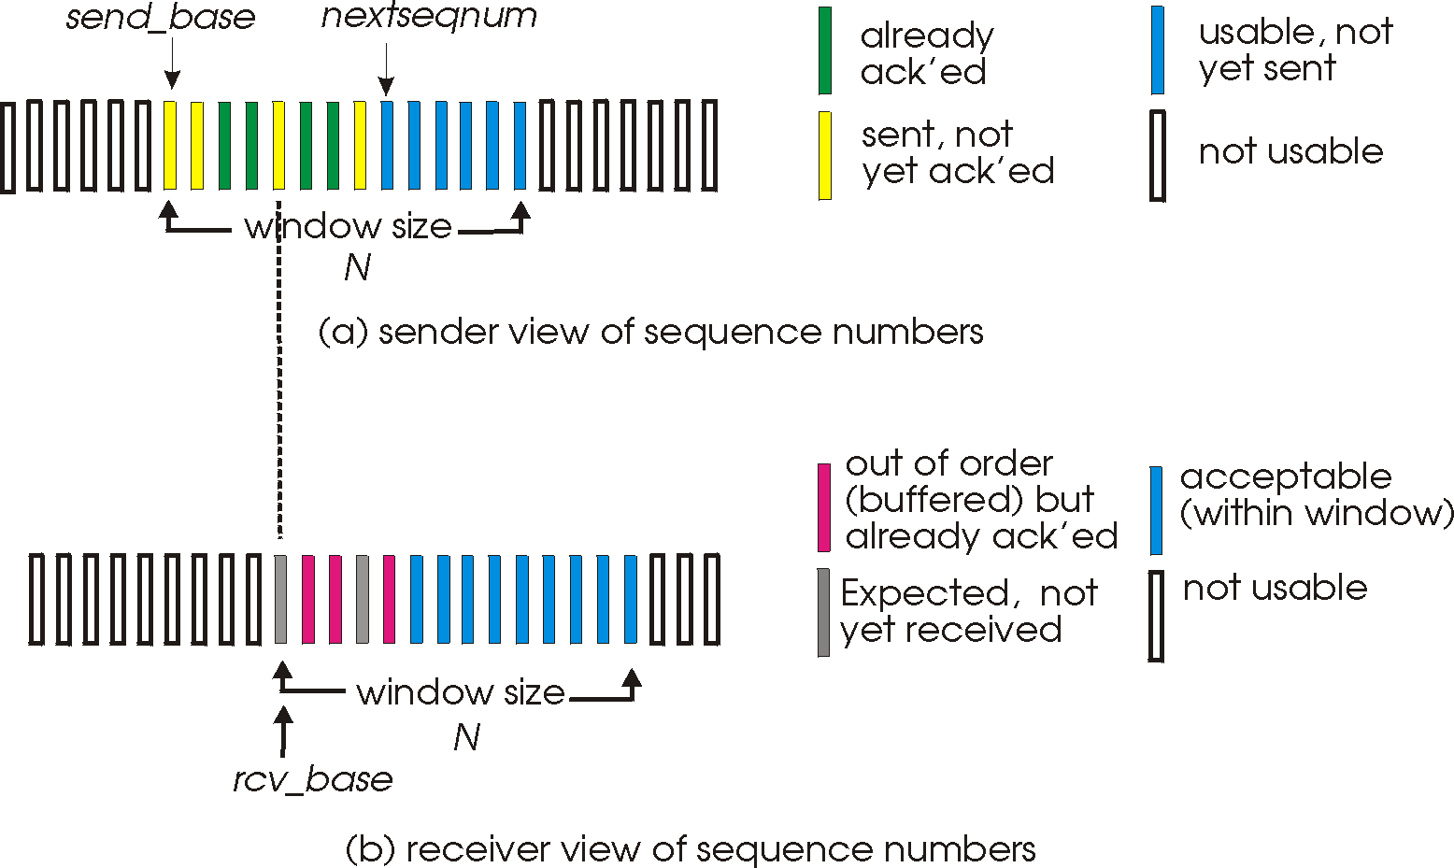
Selective repeat: sender, receiver windows

Slide 62
TCP flow control
application
process
Q: What happens if network layer delivers data faster than application layer removes data from socket buffers?
Application removing data from TCP socket buffers
TCP socket
receiver buffers
TCP
code
Network layer delivering IP datagram payload into TCP socket buffers
IP
code
from sender
receiver protocol stack
Notes:
(Presuming an intro)
Before diving into the details of TCP flow control, let’s first get the general context and motivate the need for flow control.
This diagram show a typical transport-layer implementation
A segment is brought up the protocol stack to the transport layer, and the segment’s payload is removed from the segment and written INTO socket buffers.
How does data get taken OUT of socket buffers? By applications performing socket reads, as we learned in Chapter 2.
And so the question is “What happens if network layer delivers data faster than an application-layer process removes data from socket buffers?”
Let’s watch a video of what happens when things arrive way too fast to fast to be processed.
<video>. (I love that video). Another human analogy showing the need for flow control is the saying – to use some English slang - “no one can drink from a firehose”
Flow control is a mechanism to the calamity of a receiver being over-run by a sender that is sending too fast – it allows the RECEIVER to explictly control the SENDER so sender won’t overflow receiver’s buffer by transmitting too much, too fast

Slide 63


TCP flow control
application
process
Q: What happens if network layer delivers data faster than application layer removes data from socket buffers?
Application removing data from TCP socket buffers
TCP socket
receiver buffers
TCP
code
Network layer delivering IP datagram payload into TCP socket buffers
IP
code
from sender
receiver protocol stack
Notes:
(Presuming an intro)
Before diving into the details of TCP flow control, let’s first get the general context and motivate the need for flow control.
This diagram show a typical transport-layer implementation
A segment is brought up the protocol stack to the transport layer, and the segment’s payload is removed from the segment and written INTO socket buffers.
How does data get taken OUT of socket buffers? By applications performing socket reads, as we learned in Chapter 2.
And so the question is “What happens if network layer delivers data faster than an application-layer process removes data from socket buffers?”
Let’s watch a video of what happens when things arrive way too fast to fast to be processed.
<video>. (I love that video). Another human analogy showing the need for flow control is the saying – to use some English slang - “no one can drink from a firehose”
Flow control is a mechanism to the calamity of a receiver being over-run by a sender that is sending too fast – it allows the RECEIVER to explictly control the SENDER so sender won’t overflow receiver’s buffer by transmitting too much, too fast

Slide 64
TCP flow control
application
process
Q: What happens if network layer delivers data faster than application layer removes data from socket buffers?
Application removing data from TCP socket buffers
TCP socket
receiver buffers
TCP
code
receive window
flow control: # bytes receiver willing to accept
IP
code
from sender
receiver protocol stack
Notes:
(Presuming an intro)
Before diving into the details of TCP flow control, let’s first get the general context and motivate the need for flow control.
This diagram show a typical transport-layer implementation
A segment is brought up the protocol stack to the transport layer, and the segment’s payload is removed from the segment and written INTO socket buffers.
How does data get taken OUT of socket buffers? By applications performing socket reads, as we learned in Chapter 2.
And so the question is “What happens if network layer delivers data faster than an application-layer process removes data from socket buffers?”
Let’s watch a video of what happens when things arrive way too fast to fast to be processed.
<video>. (I love that video). Another human analogy showing the need for flow control is the saying – to use some English slang - “no one can drink from a firehose”
Flow control is a mechanism to the calamity of a receiver being over-run by a sender that is sending too fast – it allows the RECEIVER to explictly control the SENDER so sender won’t overflow receiver’s buffer by transmitting too much, too fast

Slide 65
TCP flow control
application
process
Q: What happens if network layer delivers data faster than application layer removes data from socket buffers?
Application removing data from TCP socket buffers
TCP socket
receiver buffers
TCP
code
flow control
receiver controls sender, so sender won’t overflow receiver’s buffer by transmitting too much, too fast
IP
code
from sender
receiver protocol stack
Notes:
(Presuming an intro)
Before diving into the details of TCP flow control, let’s first get the general context and motivate the need for flow control.
This diagram show a typical transport-layer implementation
A segment is brought up the protocol stack to the transport layer, and the segment’s payload is removed from the segment and written INTO socket buffers.
How does data get taken OUT of socket buffers? By applications performing socket reads, as we learned in Chapter 2.
And so the question is “What happens if network layer delivers data faster than an application-layer process removes data from socket buffers?”
Let’s watch a video of what happens when things arrive way too fast to fast to be processed.
<video>. (I love that video). Another human analogy showing the need for flow control is the saying – to use some English slang - “no one can drink from a firehose”
Flow control is a mechanism to the calamity of a receiver being over-run by a sender that is sending too fast – it allows the RECEIVER to explictly control the SENDER so sender won’t overflow receiver’s buffer by transmitting too much, too fast

Slide 66
TCP flow control
TCP receiver “advertises” free buffer space in rwnd field in TCP header
RcvBuffer size set via socket options (typical default is 4096 bytes)
many operating systems autoadjust RcvBuffer
sender limits amount of unACKed (“in-flight”) data to received rwnd
guarantees receive buffer will not overflow
to application process
RcvBuffer
buffered data
rwnd
free buffer space
TCP segment payloads
TCP receiver-side buffering
Notes:
Here’s how TCP implement flow control. The basic idea is simple – the receiver informs the sender how much free buffer space there is, and the sender is limited to send no more than this amount of data. That the value o RWND in the diagram to the right.
This information is carried from the receiver to the sender in the “receiver advertised window” (do a PIP of header) in the TCP header, and the value will change as the amount of free buffer space fluctuates over time.

Slide 67
TCP flow control
flow control: # bytes receiver willing to accept
TCP receiver “advertises” free buffer space in rwnd field in TCP header
RcvBuffer size set via socket options (typical default is 4096 bytes)
many operating systems autoadjust RcvBuffer
sender limits amount of unACKed (“in-flight”) data to received rwnd
guarantees receive buffer will not overflow
receive window
TCP segment format
Notes:
Here’s how TCP implement flow control. The basic idea is simple – the receiver informs the sender how much free buffer space there is, and the sender is limited to send no more than this amount of data. That the value o RWND in the diagram to the right.
This information is carried from the receiver to the sender in the “receiver advertised window” (do a PIP of header) in the TCP header, and the value will change as the amount of free buffer space fluctuates over time.

Slide 68
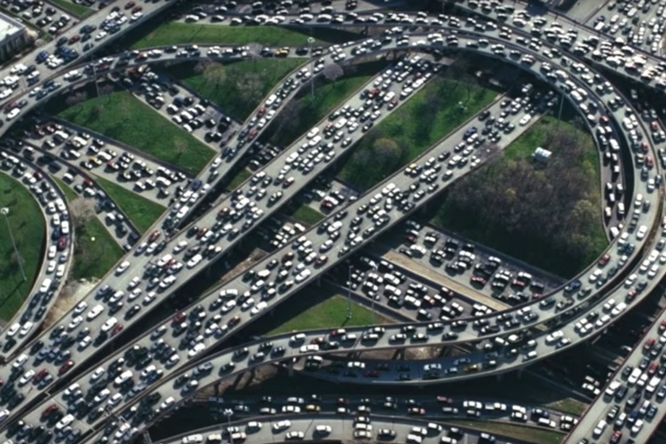
Principles of congestion control
Congestion:
informally: “too many sources sending too much data too fast for network to handle”
manifestations:
long delays (queueing in router buffers)
packet loss (buffer overflow at routers)
different from flow control!
congestion control: too many senders, sending too fast
a top-10 problem!
flow control: one sender too fast for one receiver

Slide 69
Causes/costs of congestion: scenario 1
original data: λ_{in}
throughput: λ_{out}
Simplest scenario:
Host A
one router, infinite buffers
input, output link capacity: R
infinite shared output link buffers
two flows
R
R
no retransmissions needed
Host B
R/2
Q: What happens as arrival rate λ_{in} approaches R/2?
λ_{out}
delay
throughput:
λ_{in}
R/2
λ_{in}
R/2
maximum per-connection throughput: R/2
large delays as arrival rate λ_{in} approaches capacity
R/2

Slide 70
Causes/costs of congestion: scenario 2
one router, finite buffers
sender retransmits lost, timed-out packet
application-layer input = application-layer output: λ_{in} = λ_{out}
transport-layer input includes retransmissions : λ’_{in} λ_{in}
Host A
λ_{in} : original data
λ'_{in}: original data, plus retransmitted data
λ_{out}
R
R
Host B
finite shared output link buffers

Slide 71
Causes/costs of congestion: scenario 2
Idealization: perfect knowledge
sender sends only when router buffers available
R/2
λ_{out}
throughput:
Host A
λ_{in} : original data
λ_{in}
copy
λ'_{in}: original data, plus retransmitted data
λ_{out}
R/2
free buffer space!
R
R
Host B
finite shared output link buffers

Slide 72
Evolving transport-layer functionality
TCP, UDP: principal transport protocols for 40 years
different “flavors” of TCP developed, for specific scenarios:
Scenario | Challenges
Long, fat pipes (large data transfers) | Many packets “in flight”; loss shuts down pipeline
Wireless networks | Loss due to noisy wireless links, mobility; TCP treat this as congestion loss
Long-delay links | Extremely long RTTs
Data center networks | Latency sensitive
Background traffic flows | Low priority, “background” TCP flows
moving transport–layer functions to application layer, on top of UDP
HTTP/3: QUIC

Slide 73
QUIC: Quick UDP Internet Connections
application-layer protocol, on top of UDP
increase performance of HTTP
deployed on many Google servers, apps (Chrome, mobile YouTube app)
HTTP/2
HTTP/2 (slimmed)
Application
HTTP/3
TLS
QUIC
Transport
TCP
UDP
Network
IP
IP
HTTP/2 over TCP
HTTP/2 over QUIC over UDP

Slide 74
QUIC: Quick UDP Internet Connections
adopts approaches we’ve studied in this chapter for connection establishment, error control, congestion control
error and congestion control: “Readers familiar with TCP’s loss detection and congestion control will find algorithms here that parallel well-known TCP ones.” [from QUIC specification]
connection establishment: reliability, congestion control, authentication, encryption, state established in one RTT
multiple application-level “streams” multiplexed over single QUIC connection
separate reliable data transfer, security
common congestion control

Slide 75
QUIC: Connection establishment
TCP handshake
(transport layer)
QUIC handshake
data
TLS handshake
(security)
data
TCP (reliability, congestion control state) + TLS (authentication, crypto state)
2 serial handshakes
QUIC: reliability, congestion control, authentication, crypto state
1 handshake

Slide 76
QUIC: streams: parallelism, no HOL blocking
HTTP
GET
HTTP
GET
HTTP
GET
HTTP
GET
HTTP
GET
application
HTTP
GET
QUIC
encrypt
QUIC
encrypt
QUIC
encrypt
QUIC
encrypt
QUIC
encrypt
QUIC
encrypt
TLS encryption
TLS encryption
QUIC
RDT
QUIC
RDT
QUIC
RDT
QUIC
RDT
QUIC
RDT
QUIC
RDT
error!
QUIC Cong. Cont.
QUIC Cong. Cont.
TCP RDT
TCP RDT
error!
transport
TCP Cong. Contr.
TCP Cong. Contr.
UDP
UDP
(a) HTTP 1.1
(b) HTTP/2 with QUIC: no HOL blocking

